Slide 1

Chapter 3 Transport Layer
Computer Networking: A Top-Down Approach 8th edition Jim Kurose, Keith Ross Pearson, 2020
Acknowledgement: Based on the textbook’s website: https://gaia.cs.umass.edu/kurose_ross/index.php
Notes:
Version History
8.0 (April 2020)
All slides reformatted for 16:9 aspect ratio
All slides updated to 8th edition material
Use of Calibri font, rather that Gill Sans MT
Add LOTS more animation throughout
added new 8th edition material on QUIC, CUBIC, delay-based congestion control
lighter header font
8.2 (July 2023): changes from 8.0
minor updates throughout, but not much changes from 8.0

Slide 2
Transport layer: overview
Our goal:
understand principles behind transport layer services:
multiplexing, demultiplexing
reliable data transfer
flow control
congestion control
learn about Internet transport layer protocols:
UDP: connectionless transport
TCP: connection-oriented reliable transport
TCP congestion control

Slide 3

Transport layer: roadmap
Transport-layer services
Multiplexing and demultiplexing
Connectionless transport: UDP
Principles of reliable data transfer
Connection-oriented transport: TCP
Principles of congestion control
TCP congestion control
Evolution of transport-layer functionality

Slide 4








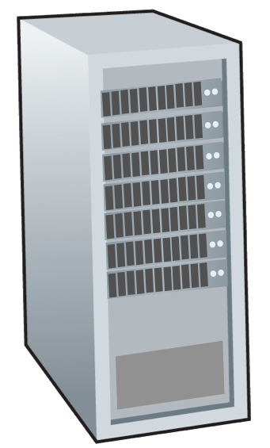







Transport services and protocols
IMPORTANT
application
transport
network
data link
physical
provide logical communication between application processes running on different hosts
mobile network
national or global ISP
transport protocols actions in end systems:
sender: breaks application messages into segments, passes to network layer
receiver: reassembles segments into messages, passes to application layer
logical end-end transport
local or regional ISP
home network
content
provider
network
application
transport
network
data link
physical
datacenter
network
two transport protocols available to Internet applications
TCP, UDP
enterprise
network
Notes:
By logical communication , we
mean that from an application’s perspective, it is as if the hosts running the processes
were directly connected; in reality, the hosts may be on opposite sides of the
planet, connected via numerous routers and a wide range of link types. Application
processes use the logical communication provided by the transport layer to send
messages to each other, free from the worry of the details of the physical infrastructure
used to carry these messages.
Let’s look at each of these three (logical communications, actions,

Slide 5
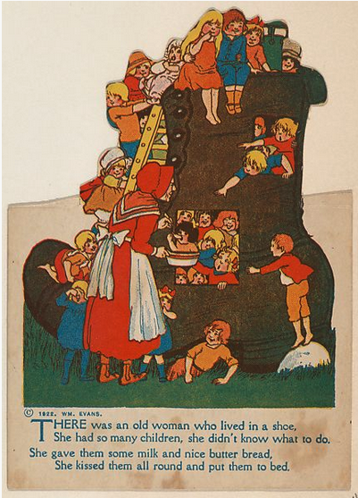
Transport vs. network layer services and protocols
IMPORTANT
household analogy:
12 kids in Ann’s house sending letters to 12 kids in Bill’s house:
hosts = houses
processes = kids
app messages = letters in envelopes
transport protocol = Ann and Bill who demux to in-house siblings
network-layer protocol = postal service

Slide 6
Transport vs. network layer services and protocols
IMPORTANT
household analogy:
transport layer: communication between processes
relies on, enhances, network layer services
12 kids in Ann’s house sending letters to 12 kids in Bill’s house:
hosts = houses
processes = kids
app messages = letters in envelopes
transport protocol = Ann and Bill who demux to in-house siblings
network-layer protocol = postal service
network layer: communication between hosts

Slide 7
Transport Layer Actions
IMPORTANT
Sender:
application
application
is passed an application-layer message
app. msg
determines segment header fields values
T_{h}
transport
app. msg
transport
T_{h}
creates segment
network (IP)
network (IP)
passes segment to IP
link
link
physical
physical

Slide 8
Transport Layer Actions
IMPORTANT
Receiver:
application
receives segment from IP
application
checks header values
transport
transport
app. msg
extracts application-layer message
network (IP)
network (IP)
demultiplexes message up to application via socket
link
link
physical
physical
app. msg
T_{h}

Slide 9
Two principal Internet transport protocols
IMPORTANT
application
transport
network
data link
physical
TCP: Transmission Control Protocol
reliable, in-order delivery
congestion control
flow control
connection setup
UDP: User Datagram Protocol
unreliable, unordered delivery
no-frills extension of “best-effort” IP
services not available:
delay guarantees
bandwidth guarantees
mobile network
national or global ISP
logical end-end transport
local or regional ISP
home network
content
provider
network
application
transport
network
data link
physical
datacenter
network
enterprise
network

Slide 10
Chapter 3: roadmap
Transport-layer services
Multiplexing and demultiplexing
Connectionless transport: UDP
Principles of reliable data transfer
Connection-oriented transport: TCP
Principles of congestion control
TCP congestion control
Evolution of transport-layer functionality

Slide 11

Multiplexing/demultiplexing
IMPORTANT
multiplexing as sender:
demultiplexing as receiver:
handle data from multiple
sockets, add transport header (later used for demultiplexing)
use header info to deliver
received segments to correct
socket
application
application
P1
P2
application
socket
P3
transport
P4
process
transport
network
transport
network
link
network
link
physical
link
physical
physical

Slide 12




IMPORTANT
HTTP server
client
application
application
HTTP msg
transport
H_{t}
HTTP msg
H_{n}
H_{t}
network
transport
HTTP msg
transport
H_{n}
H_{t}
link
network
network
HTTP msg
link
physical
link
physical
physical
H_{n}
H_{t}
HTTP msg

Slide 13

IMPORTANT
Q: how did transport layer know to deliver message to Firefox browser process rather then Netflix process or Skype process?
client
application
application
HTTP msg
HTTP msg
transport
H_{t}
HTTP msg
transport
network
transport
network
link
network
link
physical
link
physical
physical

Slide 14
IMPORTANT
?
de-multiplexing

Slide 15
IMPORTANT
application
?
transport
de-multiplexing

Slide 16
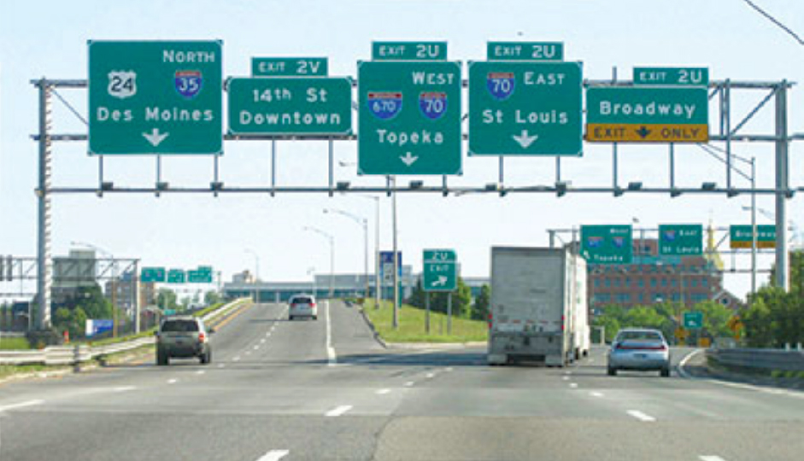
Demultiplexing

Slide 17


Slide 18
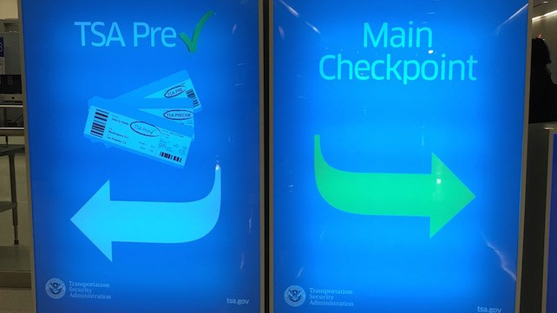

Slide 19
IMPORTANT
multiplexing

Slide 20
IMPORTANT
application
transport
multiplexing

Slide 21

Multiplexing

Slide 22
How demultiplexing works
IMPORTANT
host receives IP datagrams
each datagram has source IP address, destination IP address
each datagram carries one transport-layer segment
each segment has source, destination port number
host uses IP addresses & port numbers to direct segment to appropriate socket
32 bits
source port #
dest port #
other header fields
application
data
(payload)
TCP/UDP segment format

Slide 23
Connectionless demultiplexing
IMPORTANT
Recall:
when creating socket, must specify host-local port #:
DatagramSocket mySocket1 = new DatagramSocket(12534);
when receiving host receives UDP segment:
checks destination port # in segment
directs UDP segment to socket with that port #
when creating datagram to send into UDP socket, must specify
destination IP address
destination port #
IP/UDP datagrams with same dest. port #, but different source IP addresses and/or source port numbers will be directed to same socket at receiving host

Slide 24
Connectionless demultiplexing: an example
IMPORTANT
mySocket = socket(AF_INET,SOCK_DGRAM)
mySocket.bind(myaddr,6428);
mySocket = socket(AF_INET,SOCK_STREAM)
mySocket.bind(myaddr,9157);
mySocket = socket(AF_INET,SOCK_STREAM)
mySocket.bind(myaddr,5775);
application
application
P1
application
P3
P4
transport
transport
network
transport
network
link
network
link
physical
link
physical
physical
B
D
source port: 6428
dest port: 9157
source port: ?
dest port: ?
A
C
source port: 9157
dest port: 6428
source port: ?
dest port: ?

Slide 25
Connection-oriented demultiplexing
IMPORTANT
TCP socket identified by 4-tuple:
source IP address
source port number
dest IP address
dest port number
server may support many simultaneous TCP sockets:
each socket identified by its own 4-tuple
each socket associated with a different connecting client
demux: receiver uses all four values (4-tuple) to direct segment to appropriate socket

Slide 26
Connection-oriented demultiplexing: example
IMPORTANT
application
application
P4
P5
P6
application
P1
P2
P3
transport
transport
network
transport
network
link
network
link
physical
link
physical
server: IP address B
physical
host: IP address A
source IP,port: B,80
dest IP,port: A,9157
host: IP address C
source IP,port: C,5775
dest IP,port: B,80
source IP,port: A,9157
dest IP, port: B,80
source IP,port: C,9157
dest IP,port: B,80
Three segments, all destined to IP address: B,
dest port: 80 are demultiplexed to different sockets

Slide 27
Summary
IMPORTANT
Multiplexing, demultiplexing: based on segment, datagram header field values
UDP: demultiplexing using destination port number (only)
TCP: demultiplexing using 4-tuple: source and destination IP addresses, and port numbers
Multiplexing/demultiplexing happen at all layers

Slide 28
Quiz
IMPORTANT
https://gaia.cs.umass.edu/kurose_ross/interactive/UDP_Mux_Demux.php
https://gaia.cs.umass.edu/kurose_ross/interactive/TCP_Mux_Demux.php

